Slide 1








Albumify

Slide 2
Project Presented by:
Khush Desai
Sairantri Pathak
Atreyee Bose
Pratik Adhikary
Under the guidance of: Mr. Abhishek Saha
A Project Submitted in Partial Fulfillment of the Requirements for the Degree of Bachelor of Technology in Computer Science and Business Systems.
Department of Computer Science & Business System
Netaji Subhas Engineering College
Garia, Kolkata – 700152

Slide 3
Outline:
1. Problem Statement
2. Proposed Solution
3. Project Implementation
4. System Design
5. Future Scope
6. Conclusion

Slide 4
1
Problem Statement:
1
Organizing photos from multiple contributors after events like weddings or conferences is often tedious and inefficient.
Shared folders amass hundreds of images, leaving users to manually sort through them, identify individuals, and group photos—a process complicated by group shots and low-quality images.
Existing tools are user-specific and struggle with large-scale event photo management.
2
3

Slide 5

2
Proposed Solution:
The project, Albumify, aims to build an easy-to-use web application that helps people quickly organize and manage photos from events or shared galleries. Using advanced technologies like deep learning and artificial intelligence, the platform will recognize faces in photos and group them based on user preferences.
Core Features:
Upload photos easily using drag-and-drop or directly from devices or cloud storage.
Automatically process photos to detect, align, and group faces.
Display categorized photos in a clear, organized grid. Let users download grouped photo collections effortlessly.

Slide 6




3
Introduction:
“Albumify” operates at the intersection of computer vision, deep learning. The platform addresses the need for efficient organization by enabling users to upload their event or gallery photos into a shared pool.
By focusing on collaborative photo sharing and intelligent sorting, Albumify aims to simplify the post-event photo management process while providing users with a seamless and intuitive experience.

Slide 7



4
Tech Stack Frontend:
Vite - Vite is an ultra-fast build tool that improves the development experience by reducing the time it takes to see changes during development.
ReactJS - React allows us to create dynamic and interactive user interfaces using components.
Zustand - State management libraries to handle global application state.
Tailwind CSS - Utility-first CSS framework for flexible and responsive styling.

Slide 8



5
Tech Stack Backend:
NodeJS - NodeJS is a JavaScript runtime that allows us to build scalable and high-performance applications.
ExpressJS - Express is a minimal web framework for NodeJS, used to set up routing and middleware in our backend.
FastAPI - FastAPI is a modern, high-performance Python web framework designed for building APIs.

Slide 9

6
Tech Stack Backend:
MongoDB - MongoDB is a NoSQL database, making it perfect for storing unstructured data like images, user profiles, and face recognition results.
Mongoose - Mongoose is an ODM (Object Data Modeling) library for MongoDB. It provides a convenient way to define schemas and interact with the database

Slide 10




7
Tech Stack Additionals:
Cloudinary - Cloudinary is a powerful cloud service that simplifies image management, such as storing, optimizing, and transforming images.
ProtectedRoutes – Authentication to identify and allow correct users to login and access the application.
Postman - Postman is used for testing and documenting the APIs. It allows us to make HTTP requests, test the backend endpoints.
GitHub - GitHub is essential for version control, collaboration, and code management.

Slide 11
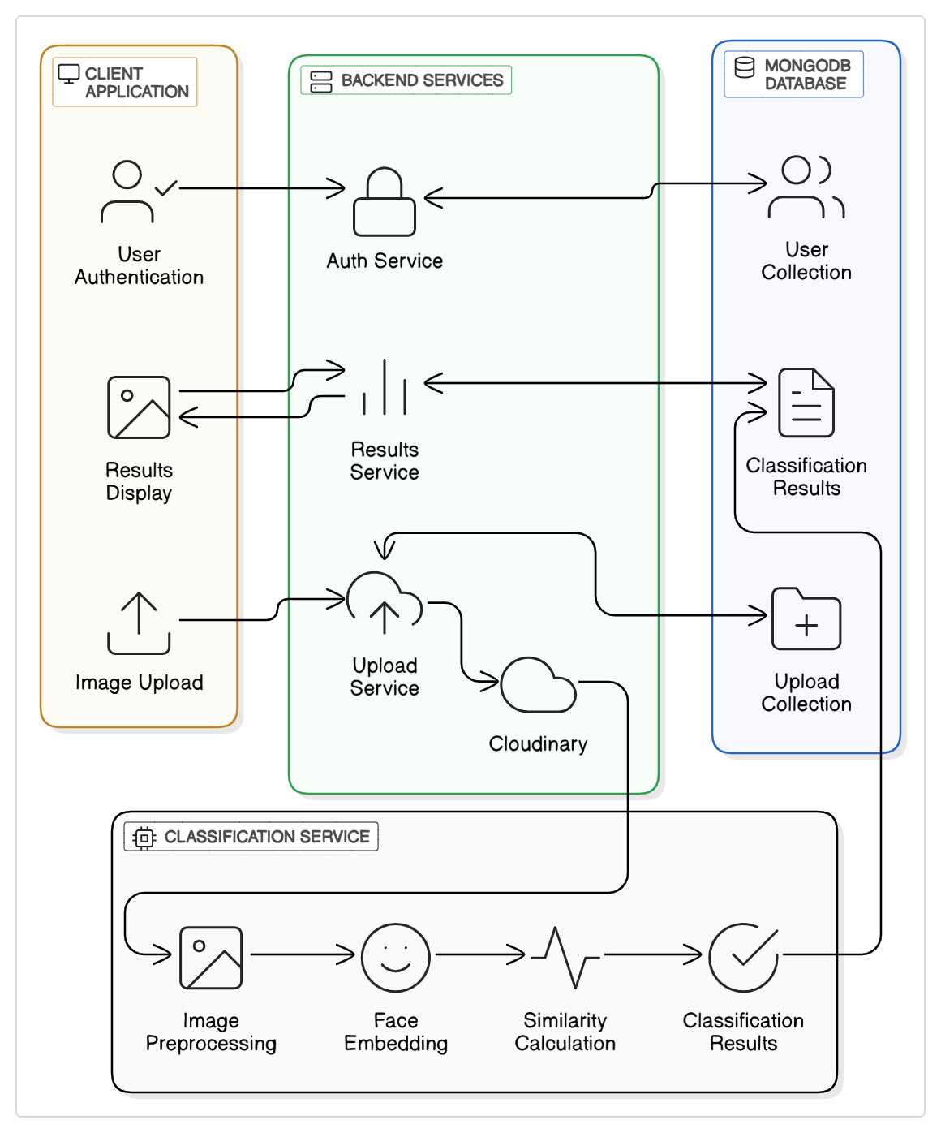
8
System
Architecture:

Slide 12
9
Frontend Overview:
The frontend is a dynamic website designed to provide a user-friendly interface for interacting with the face recognition and classification system. It allows users to upload images containing faces through an intuitive file upload feature.
Once an image is uploaded, the frontend will send it to the backend for processing. The website also handles the download of results, and will automatically download the classified set as a zip folder.

Slide 13
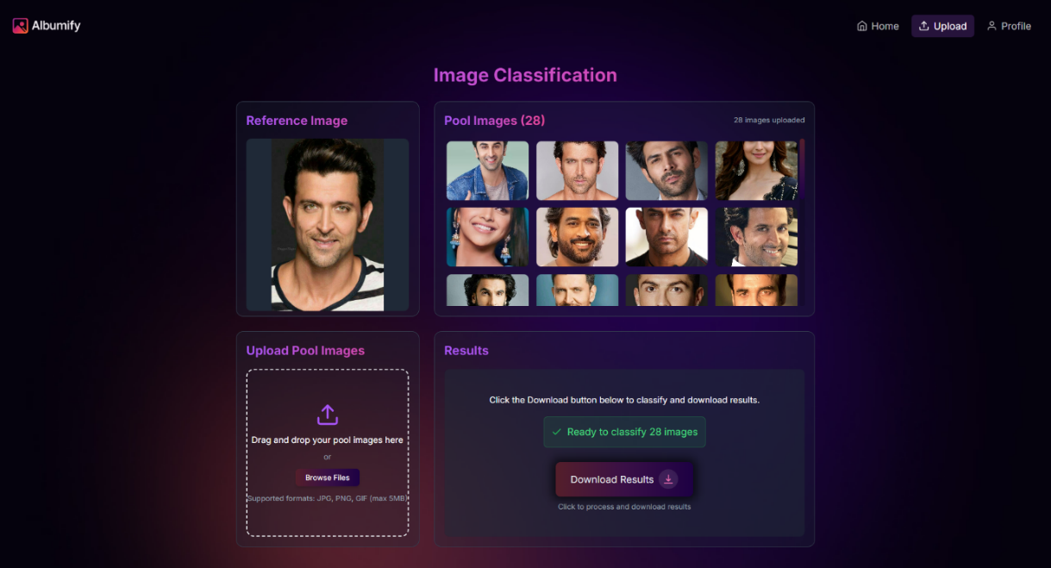

10
Frontend Overview:

Slide 14
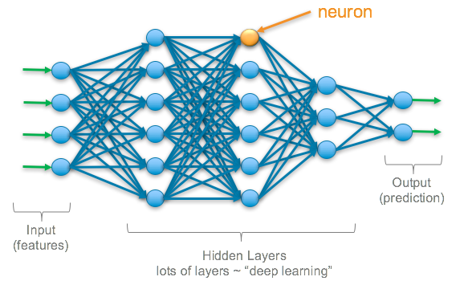
11
Model Overview:
The core of the system is a deep learning model, which utilizes a custom CNN Architecture (with a fallback mechanism to ResNet50V2 or Efficientnet).The model is designed for face recognition and classification.
The model then extracts features from the faces using its convolutional layers and attention mechanism - passes these features through fully connected layers for classification.
Once the processing is complete, the model annotates the image and classifies them into matched and unmatched

Slide 15
12
System Design:
Home Page
Home Page
Registration Page
User Registration
Detail Validation
Welcome Page
Login Page
Credential Input
Success
Auth Options
Auth Failure
Auth Success
Failure

Slide 16
13
System Design:
Classification Process
Processing State
(Backend Py Model)
Result Page
Upload Page
Reference Image Upload
Classified Grid Display
Backend Submission
Image Cluster Upload
Classification
Complete
Image Processing
Image Grouping
Image
Submission
Validation
Face Detection
Various Download Options
Invalid
Cluster Generation
Valid
Upload Error
Logout Process
Processing State
Result Preparation
Session Termination
Cache Clearing
User Logout

Slide 17
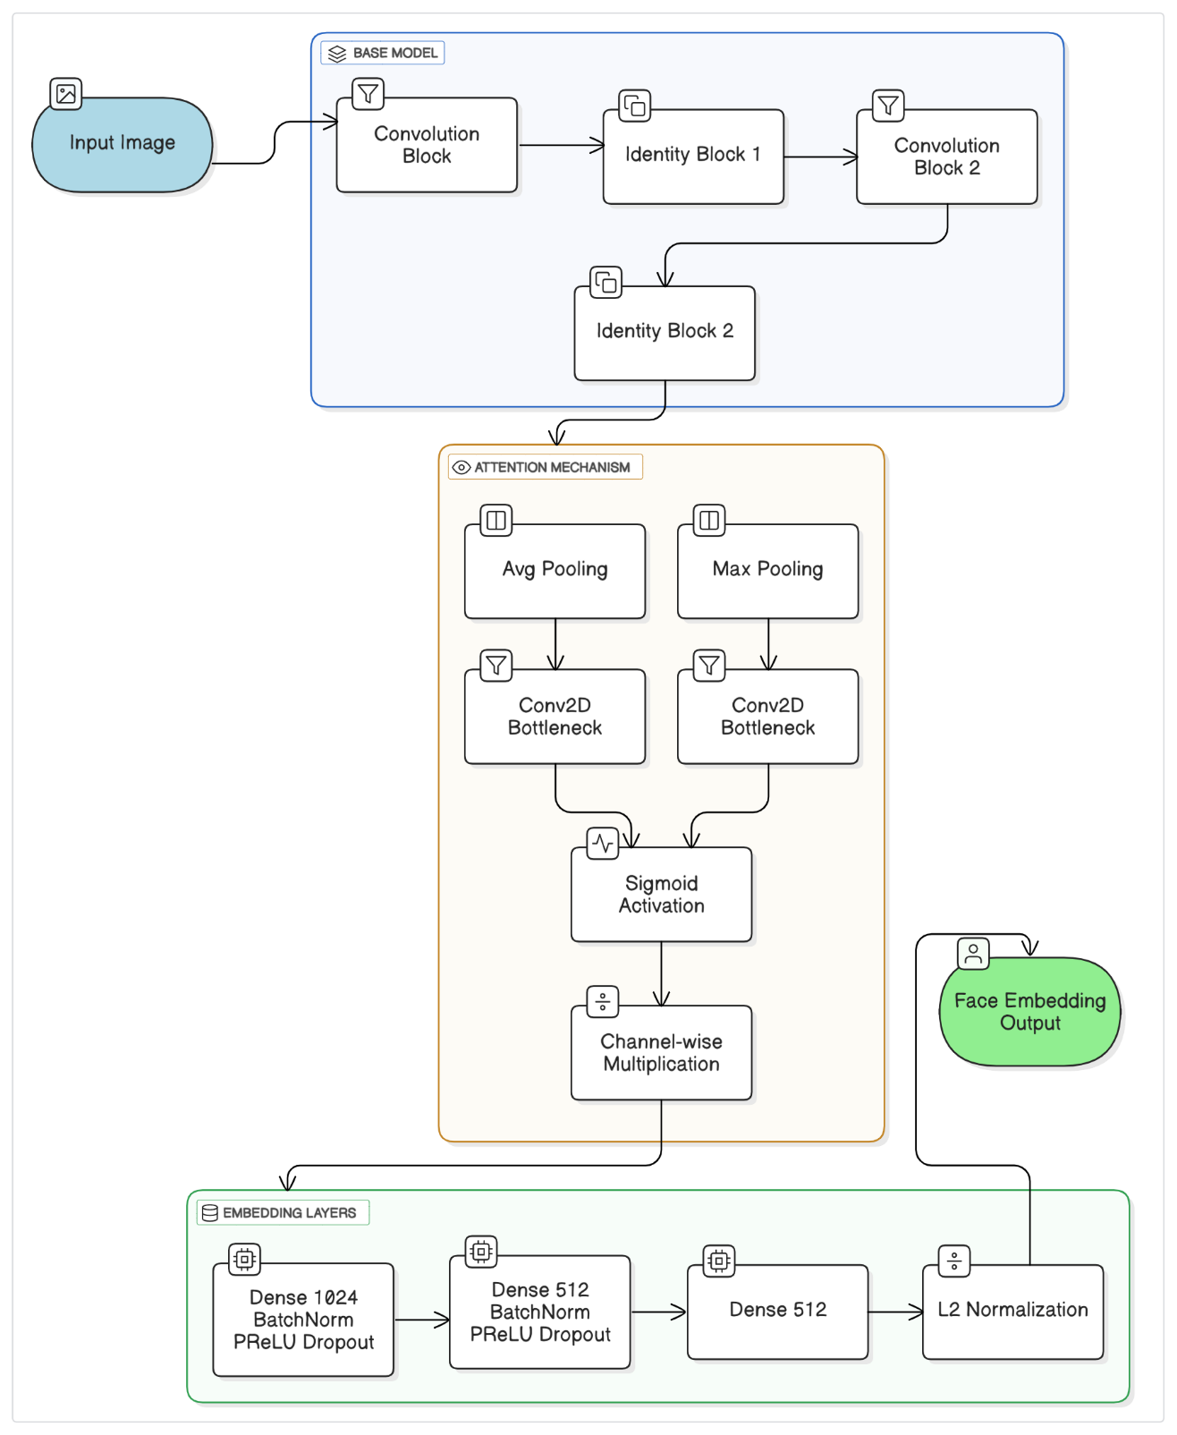
14
Model
Architecture:

Slide 18
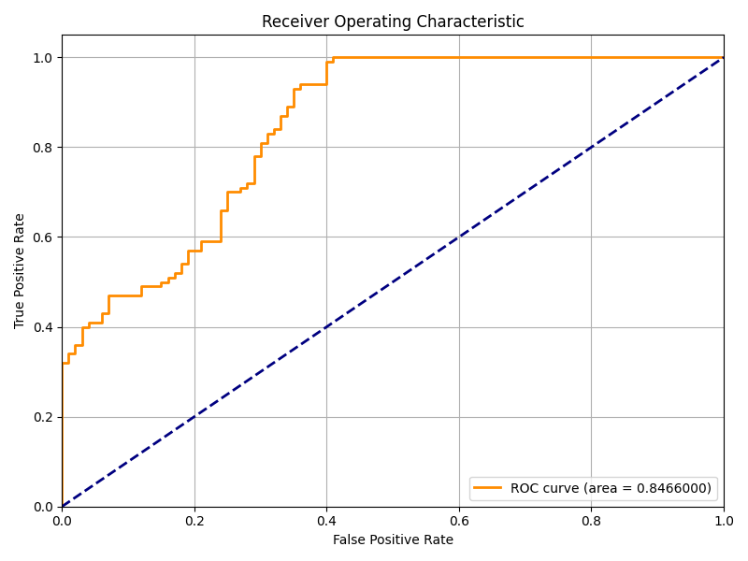
15
Model Metrics:
Training and Testing
Metric | Value
Optimal Similarity Threshold | 0.854
PR AUC | 0.829
ROC AUC | 0.847
t-SNE Clustering Quality | Distinct clusters, minimal overlap
Same Identity Mean Similarity | ≈0.94–0.98
Different Identity Mean Similarity | ≈0.80–0.85
Overall Accuracy | ≈82%

Slide 19
16
Future Scope:
Enhanced Feature Recognition
Activity-Based Categorization:
Expression Analysis
Multi-Label Classification
2. Scalability and Integration
Integration with Photo Platforms: Collaborate with popular platforms like Google Photos or social media for direct import and export of images.
3. Improved Accuracy
Advanced Models
Personalization
4. Mobile and Cross-Platform Support
Create a mobile app to allow users to organize photos on-the-go.
Develop cross-platform compatibility for seamless operation on various devices and operating systems.

Slide 20

17
Conclusion:
The project discussed above provides the foundational technology for "Albumify," a platform designed to revolutionize photo management for shared events and galleries. By leveraging advanced face recognition and classification techniques, the project automates the identification and categorization of images based on user-specified faces.
The implemented pipeline, comprising robust face detection, alignment, normalization, and embedding generation using deep learning models, ensures high accuracy and reliability in face classification. Features like batch processing, visualization, and customizable similarity thresholds enhance the user experience.
"Albumify" addresses a critical need in the digital age: managing and curating large, shared photo collections with ease.

Slide 21








Thank You

